Slide 1

Stock price prediction
Burak Efe
Tim Oldörp

Slide 2


Table of Content
Introduction
Project Goals
Data
Model and Methods
Results
Outlook
Notes:
Directional Accuracy (DA): An exceptional DA would be above 70%, indicating that the model correctly predicts the direction of price movement more than 70% of the time.
Mean Absolute Error (MAE): An exceptional MAE would be less than 1% of the average stock price. For example, if the stock price is typically around $150, an MAE of less than $1.5 would be exceptional.

Slide 3
Background
In the world of finance, predicting stock prices is crucial for investors and analysts. Machine learning techniques, particularly those involving neural networks, have gained popularity due to their ability to model complex patterns in time series data.

Slide 4

The problem we want to solve
Traditional methods of stock price prediction often struggle to capture the intricate relationships in financial data. The aim of this project is to explore the effectiveness of Long Short-Term Memory (LSTM) networks, a type of recurrent neural network (RNN), for predicting stock prices using historical data and technical indicators.
Notes:
LSTMs have connections that allow them to maintain and utilize information from previous time steps, making them effective at capturing temporal dependencies in sequential data
A Recurrent Neural Network (RNN) is a class of artificial neural networks designed to recognize patterns in sequences of data, such as time series

Slide 5


Project Goal
Primary Objective
To develop an LSTM-based model to predict future stock prices of a given ticker symbol using historical price data and technical indicators.
Secondary Objectives
To evaluate the model's performance using metrics such as Mean Absolute Error (MAE) and Directional Accuracy (DA).
To optimize the model's hyperparameters using Optuna for improved prediction accuracy.
Notes:
Directional Accuracy (DA): An exceptional DA would be above 70%, indicating that the model correctly predicts the direction of price movement more than 70% of the time.
Mean Absolute Error (MAE): An exceptional MAE would be less than 1% of the average stock price. For example, if the stock price is typically around $150, an MAE of less than $1.5 would be exceptional.

Slide 6
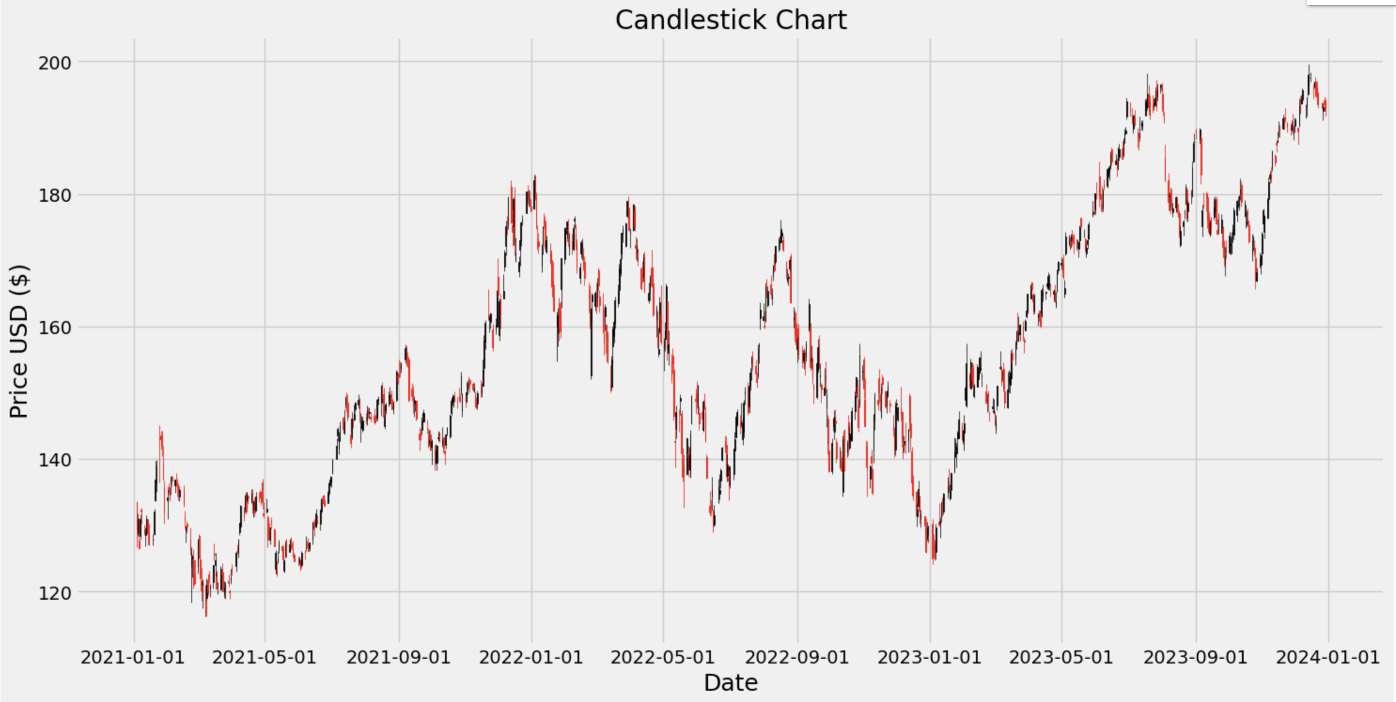
DATA

Slide 7



DATA
Data Source:
Yahoo Finance: The stock data is downloaded using the yfinance library, which provides historical market data.
Data Range:
Time Period: January 1, 2021, to January 1, 2024.
Ticker Symbol: User-specified (e.g., AAPL).
Data Features:
Raw Features: Open, High, Low, Close, Volume.
Technical Indicators: Simple Moving Average (SMA), Exponential Moving Average (EMA), Relative Strength Index (RSI), Moving Average Convergence Divergence (MACD), Bollinger Bands (High and Low).

Slide 8


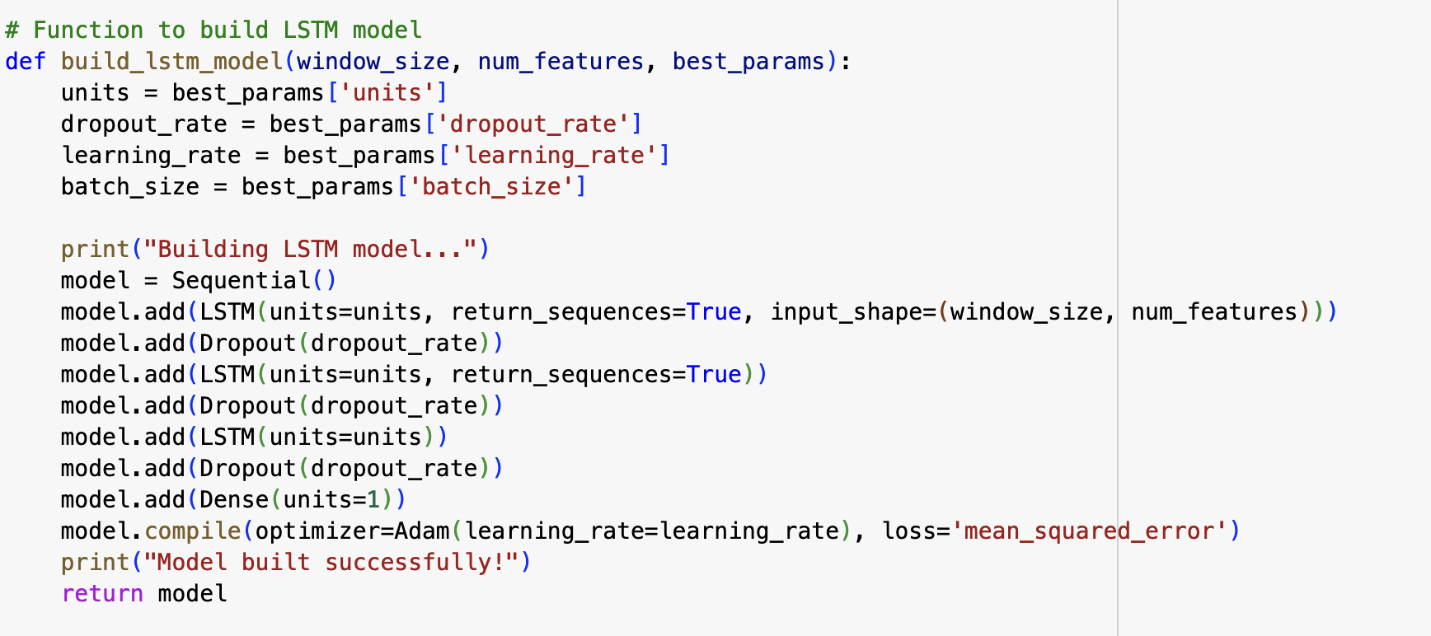
Models and Methods
Model:
Model Architecture: An LSTM network with multiple layers is constructed.
Hyperparameter Optimization: Optuna is used to tune hyperparameters like the number of units in LSTM layers, dropout rate, learning rate, and batch size.

Slide 9
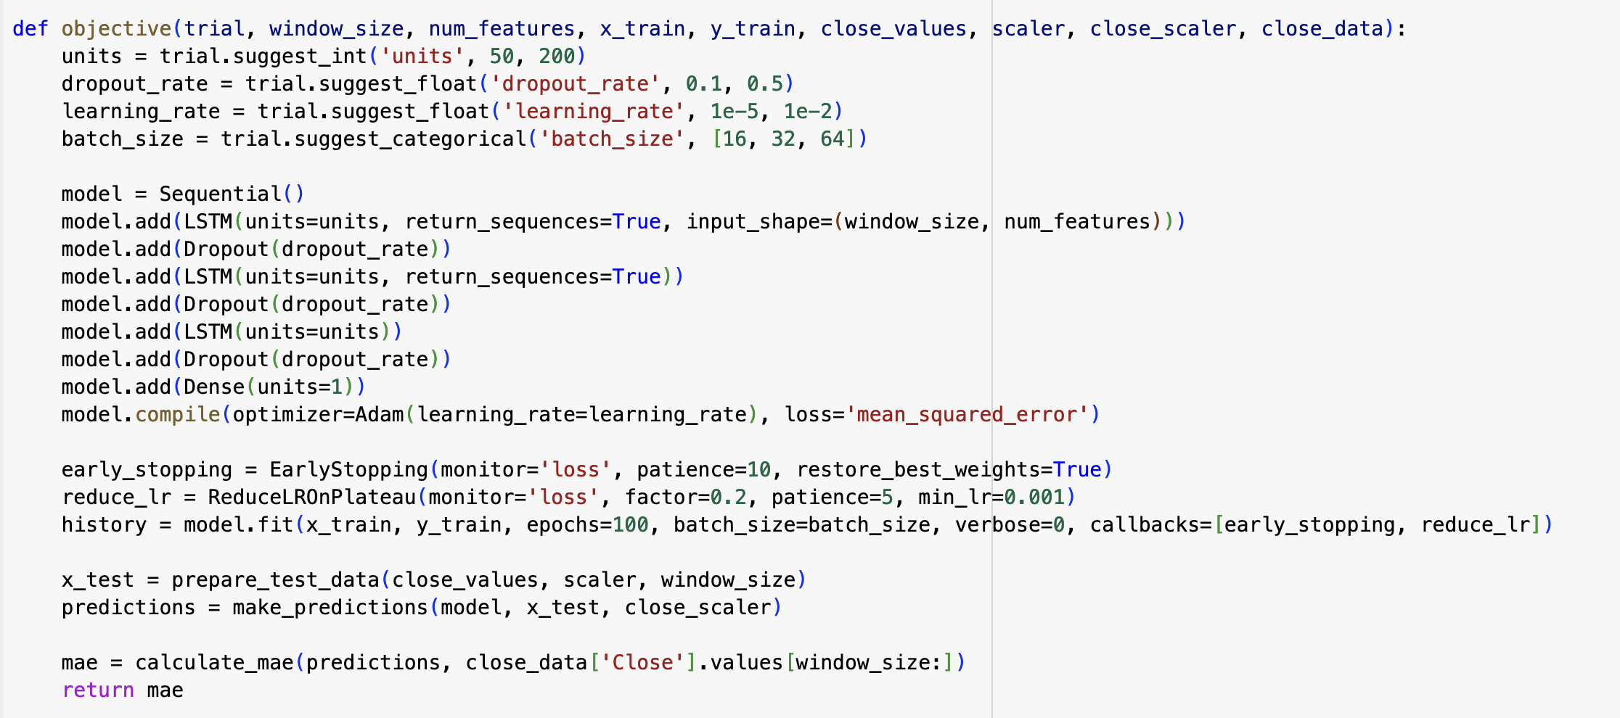
Models and Methods
Model:

Slide 10

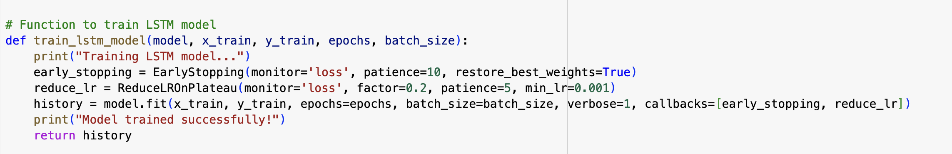
Models and Methods
Training:
Training Data Preparation: The data is segmented into training windows.
Model Training: The LSTM model is trained with early stopping and learning rate reduction techniques to prevent overfitting and enhance convergence.

Slide 11

Models and Methods
Evaluation Metrics:
Directional Accuracy (DA): Measures the accuracy of the model in predicting the direction of price movement.
Mean Absolute Error (MAE): Measures the average magnitude of the errors in the predictions

Slide 12
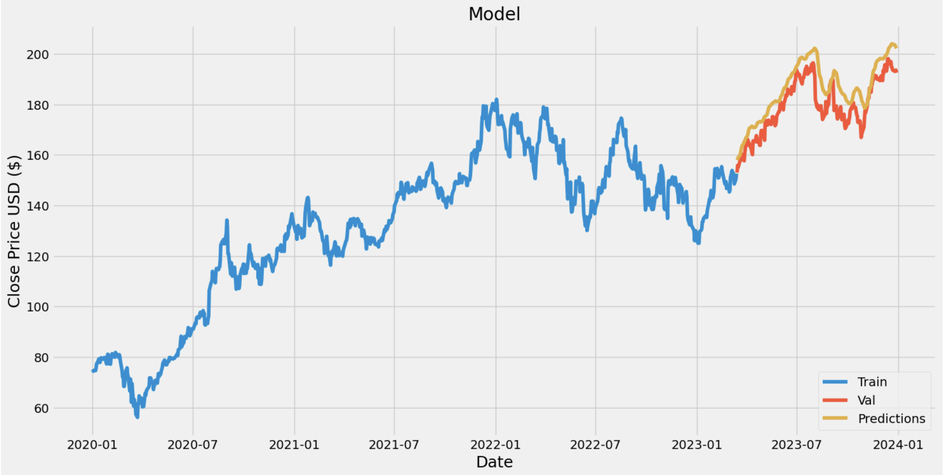
Results

Slide 13
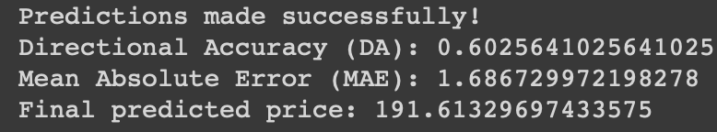
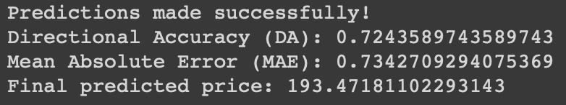
Before tuning with optuna Hyperparameters
After tuning with optuna Hyperparameters

Slide 14
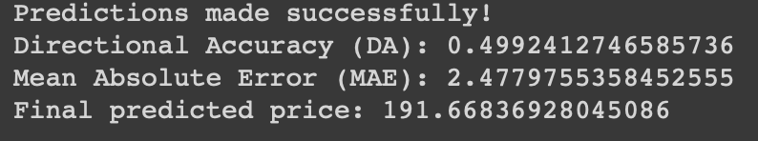
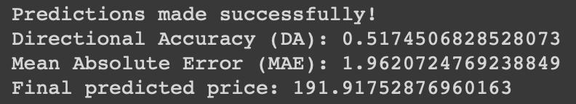
Before tuning with optuna Hyperparameters
After tuning with optuna Hyperparameters

Slide 15
Outlook
Possible improvements for our model:
Data Preprocessing and Feature Engineering
Model Architecture
Training Process
Regularization Techniques
Ensemble Methods
Advanced Techniques
Model Evaluation and Validation

Slide 16
Thank You
For your attention

